Slide 1
Module 9 Part 1
Big Data technologies
Harvinder S Jabbal
SSZG653 Software Architectures

Slide 2
Contents
Big data
Hadoop, HDFS, Map-Reduce
Analytics & Real time analytics
In-Memory database
NoSQL databases
November 4, 2023
SE ZG651/ SS ZG653 Software Architectures

Slide 3
Big data & Analytics
Wikipedia defines "Big Data" as a collection of data sets so large and complex that it becomes difficult to process using on-hand database management tools or traditional data processing applications.
November 4, 2023
SE ZG651/ SS ZG653 Software Architectures

Slide 4
History of Big Data
Lots of data got created due to
  Proliferation of Internet
  Social media
  eCommerce
November 4, 2023
SE ZG651/ SS ZG653 Software Architectures

Slide 5
Before we begin, let us understand the scale of data we deal with
Unit Power of 10
Mega byte 6
Giga 9
Tera 12
Peta 15
November 4, 2023
SE ZG651/ SS ZG653 Software Architectures

Slide 6
Big Data Statistics
Volume of data
  500+ new websites are created every minute of the day
  100 Terabytes of data is uploaded to Facebook every day
  Twitter generates 12 Terabytes of data every day
  YouTube users upload 48 hours of new video content every minute of the day
Processing
  Decoding of the human genome used to take 10 years. Now it can be done in 7 days
  Facebook Stores, Processes, and Analyzes more than 30 Petabytes of user generated data
  LinkedIn processes and mines Petabytes of user data to power the "People You May Know" feature
Source: Wikibon - A Comprehensive List of Big Data Statistics
November 4, 2023
SE ZG651/ SS ZG653 Software Architectures

Slide 7
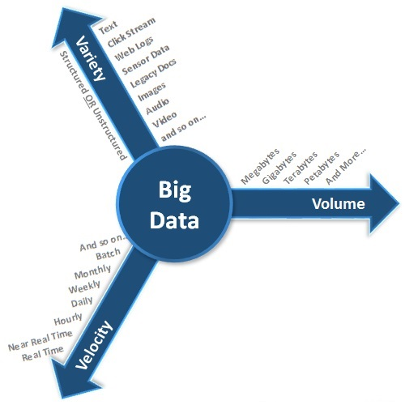
Characteristics of Big data
Surveillance videos, satellites images, cell phone location, health of power station turbines, furnaces & other industrial machinery, weather and meteorological data, click stream
Archived data:
Patient records, Scanned copies of agreements, records of ex-employees/completed projects, banking transactions older than the compliance regulations
Ex. Trading/stock exchange data, tweets on Twitter, status updates/likes/shares on Facebook
November 4, 2023
SE ZG651/ SS ZG653 Software Architectures

Slide 8
Use of big data
Recommend cancer medication based on what worked well in similar situations for other patients
Weather prediction for fishermen, farmers
Predict equipment malfunctioning in large nuclear power plant, chemical plants, etc.
Credit card fraud detection
November 4, 2023
SE ZG651/ SS ZG653 Software Architectures

Slide 9
Example of handling big data
November 4, 2023
SE ZG651/ SS ZG653 Software Architectures

Slide 10
Google search
Do you know how Google Search works?
3 steps:
Catalog & index: Even before you search, Google goes through various web sites and linked web sites (crawling) and catalogs all the web sites. This runs into several Tera bytes.
Understand & enrich your query: Correct spelling mistakes, consider synonyms, etc.
Search: When the search is requested, it uses this catalog to determine which web sites closely match the requirement. For this it uses a ‘Page Rank’ (named after Larry Page) algorithm which considers factors such as which page has max number of occurrences of the search string, how many other web sites refer to this web site, what is the reputation of the websites that refer to this website, etc.
November 4, 2023
SE ZG651/ SS ZG653 Software Architectures

Slide 11
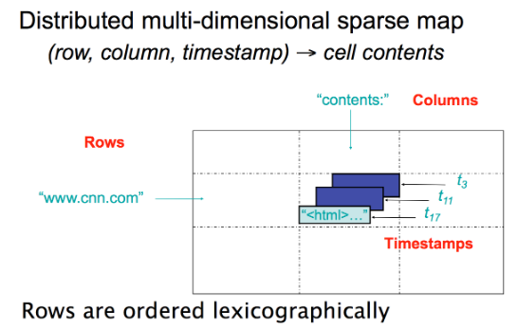
Google – Big table
So Google invented a data storage structure called Big Table
November 4, 2023
SE ZG651/ SS ZG653 Software Architectures

Slide 12
Google BigTable
Google BigTable is a wide table containing several attributes of a website;
Here are some attributes:
  The contents of Web page
  Anchor text*
  Websites referencing the page.
  Time stamp when the data was stored
Google BigTable is built on technologies like Google File System (GFS)
Google BigTable is used by applications such as Google Maps, Google Analytics, etc.
November 4, 2023
SE ZG651/ SS ZG653 Software Architectures
*Anchor text is the text that appears in Blue colour in search result. It contains a link to the website

Slide 13
Google Big Table
Features:
  Versioning of data,
  Compression,
  Distribution across servers,
  Fault tolerant,
  Fast access,
  Dynamic addition of servers,
  Load balancing
Google disclosed the design of Big table. Then came Hadoop Distributed File System (Yahoo) and serveral NoSQL databases
November 4, 2023
SE ZG651/ SS ZG653 Software Architectures

Slide 14
Use of Big Data
Banking and Financial Services
  Fraud Detection to detect the possible fraud or suspicious transactions in Accounts, Credit Cards, Debit Cards, and Insurance etc.
Retail
  Targeting customers with different discounts, coupons, and promotions etc. based on demographic data like gender, age group, location, occupation, dietary habits, buying patterns, and other information which can be useful to differentiate/categorize the customers.
Sentiment Analysis
  Organizations use the data from social media sites like Facebook, Twitter etc. to understand what customers are saying about the company, its products, and services.
  Words like “I like this phone”, “This food is too salty”, etc.. indicate sentiments
  This type of analysis is also performed to understand which companies, brands, services, or technologies people are talking about.
November 4, 2023
SE ZG651/ SS ZG653 Software Architectures

Slide 15
Use of Big Data …
Customer Service
  IT Services and BPO companies analyze the call records/logs to gain insights into customer complaints and feedback, call center executive response/ability to resolve the ticket, and to improve the overall quality of service.
  Call center data from telecommunications industries can be used to analyze the call records/logs and optimize the price, and calling plan, messaging plan, and data plans
Industrial equipment monitoring & alerting
  A large power plant or chemical factory has thousands of critical equipment that needs to be monitored
  The equipment data needs to be analysed to detect any malfunctioning or danger of accidents
Weather forecasting
  Satellite data from remote sensing satellites need to be analysed at high speed to warn fishermen, farmers and public about potential cyclones, delayed monsoon, etc.
November 4, 2023
SE ZG651/ SS ZG653 Software Architectures

Slide 16
BigTable can be used to store…
Time-series data, such as CPU and memory usage over time for multiple servers.
Marketing data, such as purchase histories and customer preferences.
Financial data, such as transaction histories, stock prices, and currency exchange rates.
Internet of Things data, such as usage reports from energy meters and home appliances.
Graph data, such as information about how users are connected to one another.
November 4, 2023
SE ZG651/ SS ZG653 Software Architectures

Slide 17
Big data architecture / Eco-system
Hive
(DW)
Data Visualization Predictive Analytics
(SAS, Tableau)
Real-time Analytics
Other apps
(Healthcare,..)
Applications
Execution engine
MapReduce
Spark
(In-mem processing, Stream, ML)
NoSQL database
(MongoDB, Cassandra)
Storage system
HDFS
(Hadoop Distributed File System)
Data sources
Bloomberg
Dow Jones
Four Square
Twitter
In-house apps
Corporate Financial news & data
Stock market news & data
City guide based on user browsing history
November 4, 2023
SE ZG651/ SS ZG653 Software Architectures

Slide 18
Hadoop
Hadoop is an open source framework, from the Apache foundation, capable of processing large amounts of heterogeneous data sets in a distributed fashion across clusters of commodity computers and hardware using a simplified programming model.
Hadoop provides a reliable shared storage and analysis system.
November 4, 2023
SE ZG651/ SS ZG653 Software Architectures

Slide 19
Components of Hadoop
HDFS (Hadoop Distributed File System)
  HDFS offers a highly reliable and distributed storage, and ensures reliability, even on a commodity hardware, by replicating the data across multiple nodes.
  Unlike a regular file system, when data is pushed to HDFS, it will automatically split into multiple blocks (configurable parameter) and stores/replicates the data across various data nodes. This ensures high availability and fault tolerance.
MapReduce
  MapReduce offers an analysis system which can perform complex computations on large datasets.
  This component is responsible for performing all the computations and works by breaking down a large complex computation into multiple tasks and assigns those to individual worker/slave nodes and takes care of coordination and consolidation of results
November 4, 2023
SE ZG651/ SS ZG653 Software Architectures

Slide 20
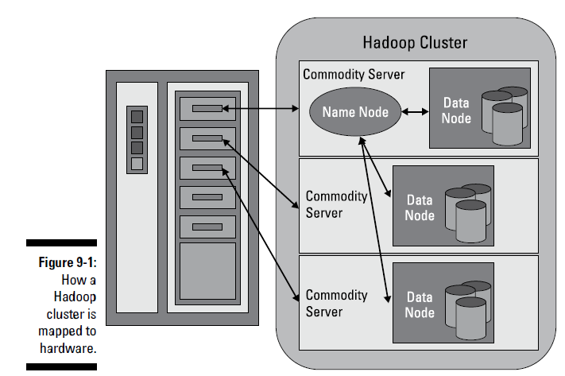
Hadoop - HDFS
Ref: Big data for Dummies
November 4, 2023
SE ZG651/ SS ZG653 Software Architectures

Slide 21
Hadoop - HDFS
Data
  Large files are broken down into blocks (128 MB usually) and spread across Data nodes.
  Data blocks are replicated and Degree of replication can be adjusted
Meta data
  Name node stores meta data – data about files, distribution of data (which block is in which nodes), etc.
  For good performance, all the metadata is loaded into the physical memory of the NameNode server.
Features
  Data nodes provide Heart beat messages to Name node
  Supports data pipelines. A connection between data nodes to move data from one node to another
  Rebalancer: Balances distribution of data
November 4, 2023
SE ZG651/ SS ZG653 Software Architectures

Slide 22
Map-Reduce pattern
Used to analyse vast amount of data
Suppose we keep track of every click of the user on a web site and store these details in a database
Let us say we want to find out the average time spent by users on each web page of the web site, across thousands of users who visited the web site in the last 30 days
How can we speed up the analysis?
November 4, 2023
SE ZG651/ SS ZG653 Software Architectures

Slide 23
Map-Reduce pattern: Example
DB
DB
DB
Analyse data on this server
Analyse data on this server
Analyse data on this server
Web page | Avg. time spent | # of visits
Web page | Avg. time spent | # of visits
Web page | Avg. time spent | # of visits
DB
Web page | Avg. time spent
Calculate weighted average
November 4, 2023
SE ZG651/ SS ZG653 Software Architectures

Slide 24
Map-Reduce pattern
Executes in parallel
Leads to low latency & high availability
Map performs extract & transform and produces <Key, Value> instances
Reduce summarizes transformed data
November 4, 2023
SE ZG651/ SS ZG653 Software Architectures

Slide 25
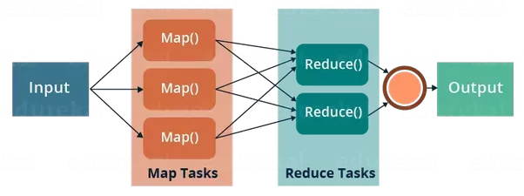
Map Reduce pattern
Source: https://www.quora.com/What-is-the-relationship-between-MapReduce-and-Hadoop
November 4, 2023
SE ZG651/ SS ZG653 Software Architectures

Slide 26
Map-Reduce pattern
Example: Determine the average time (duration) spent by users on different web pages
Step 1: Map processes data on each node are outputs <Web page, (Avg time, # of users)>
Step 2: Reduce produces <Web page, weighted Avg time>
November 4, 2023
SE ZG651/ SS ZG653 Software Architectures

Slide 27
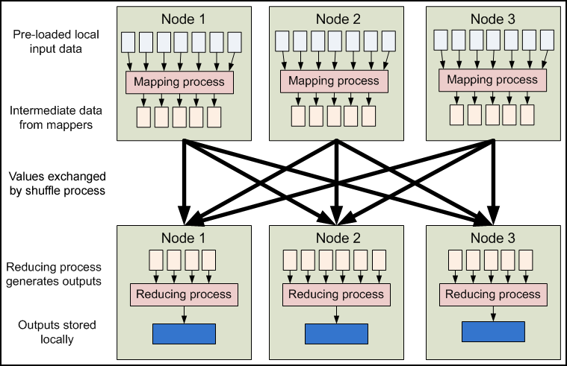
Map – Reduce pattern
Example: Determine the average duration spent by users on different web pages
November 4, 2023
SE ZG651/ SS ZG653 Software Architectures

Slide 28
Experience Sharing
Have you come across systems that use this pattern?
November 4, 2023
SE ZG651/ SS ZG653 Software Architectures

Slide 29
Hadoop - HDFS
Features
  Can store peta bytes of data
  Distributed
  Replicated
  Fault tolerant (self healing)
November 4, 2023
SE ZG651/ SS ZG653 Software Architectures

Slide 30
Using Hadoop
When to Use Hadoop (Hadoop Use Cases)
Hadoop can be used in various scenarios including some of the following:
  Analytics
  Search
  Data Retention
  Log file processing
  Analysis of Text, Image, Audio, & Video content
  Recommendation systems like in E-Commerce Websites
When Not to Use Hadoop
There are few scenarios in which Hadoop is not the right fit. Following are some of them:
  Low-latency or near real-time data access.
  If you have a large number of small files to be processed. This is due to the way Hadoop works. Namenode holds the file system metadata in memory and as the number of files increases, the amount of memory required to hold the metadata increases.
  Multiple writes scenario or scenarios requiring arbitrary writes or writes between the files.
November 4, 2023
SE ZG651/ SS ZG653 Software Architectures

Slide 31
Hadoop may still be slower for some use cases
Sometimes we require even faster processing than Map-Reduce, for example in real time fraud detection
Map Reduce is disk based
If we can retrieve disk data into memory and then use it for further processing, we can get even better response time
November 4, 2023
SE ZG651/ SS ZG653 Software Architectures

Slide 32
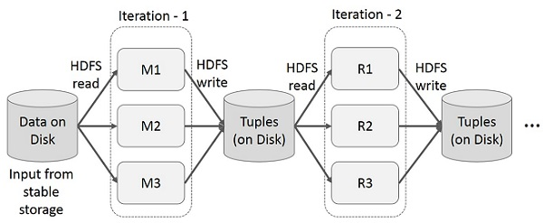
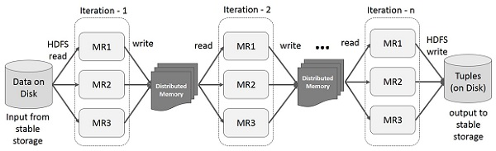
Difference between Hadoop & Spark
Iterative operation using Hadoop using disk
Iterative operation using Spark using memory
Source: https://www.tutorialspoint.com/apache_spark/apache_spark_rdd.htm
November 4, 2023
SE ZG651/ SS ZG653 Software Architectures

Slide 33
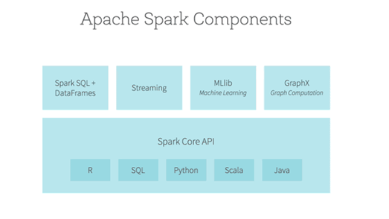
Apache Spark
Apache Spark is open source, general-purpose distributed computing engine used for processing and analyzing a large amount of data
Main feature: In-memory cluster computing
Useful for real time computations
November 4, 2023
SE ZG651/ SS ZG653 Software Architectures

Slide 34
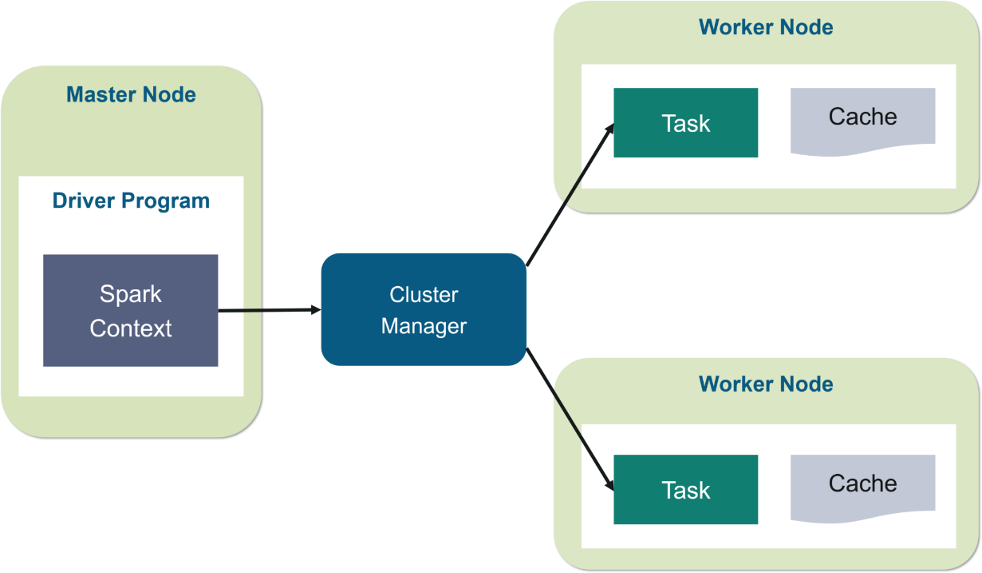
Spark architecture
November 4, 2023
SE ZG651/ SS ZG653 Software Architectures

Slide 35
Real time analytics
Real time analytics lets users see, analyze and understand data as it arrives in a system.
It can give users insights for making real-time decisions.
Examples:
  Real time advertising
  Identify security breaches
  Sensor data processing to predict issues in machines
November 4, 2023
SE ZG651/ SS ZG653 Software Architectures

Slide 36
Real time analytics - Fraud detection in bank
Continuous monitoring of client’s activity to see if there are any potential issues
Suspicious activities pipe
Send SMS to customer
Mobile
Pipe containing all user activities
Laptop
Inform security personnel
Check for fraud, looking for certain patterns
ATM
Normal activities pipe
Ex. Sudden increase in ATM withdrawals & POS spends
Process request
PoS
November 4, 2023
SE ZG651/ SS ZG653 Software Architectures

Slide 37
Real time analytics at Dream11 – a fantasy sports platform
Objectives:
Know the real-time rate of contest joins
Know the real-time aggregated status of payment gateways
Identify real-time anomalies eg: unusual traffic on the system
Realtime aggregated view of outcome of marketing campaigns
How customers are using discount coupons once promotion goes live
Realtime alerting once Mega contest is above 90%
November 4, 2023
SE ZG651/ SS ZG653 Software Architectures

Slide 38
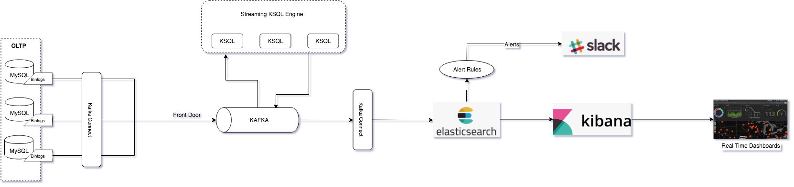
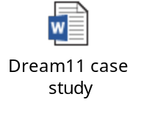
Real time analytics at Dream11 – a fantasy sports platform
Perform data enrichment
Anomaly detection & Alerts
Kafka
Real-time data store
Monitoring
Transaction systems
Ref: medium.com
November 4, 2023
SE ZG651/ SS ZG653 Software Architectures

Slide 39
IoT: Internet of Things
Inter-connected devices which work together and perform operations with little human intervention
Examples:
Tracking machine parameters using sensors and controlling for optimum performance
Tracking goods, real time information exchange about inventory among suppliers and retailers
Sensing for soil moisture and nutrients, controlling water usage for plant growth
November 4, 2023
SE ZG651/ SS ZG653 Software Architectures

Slide 40
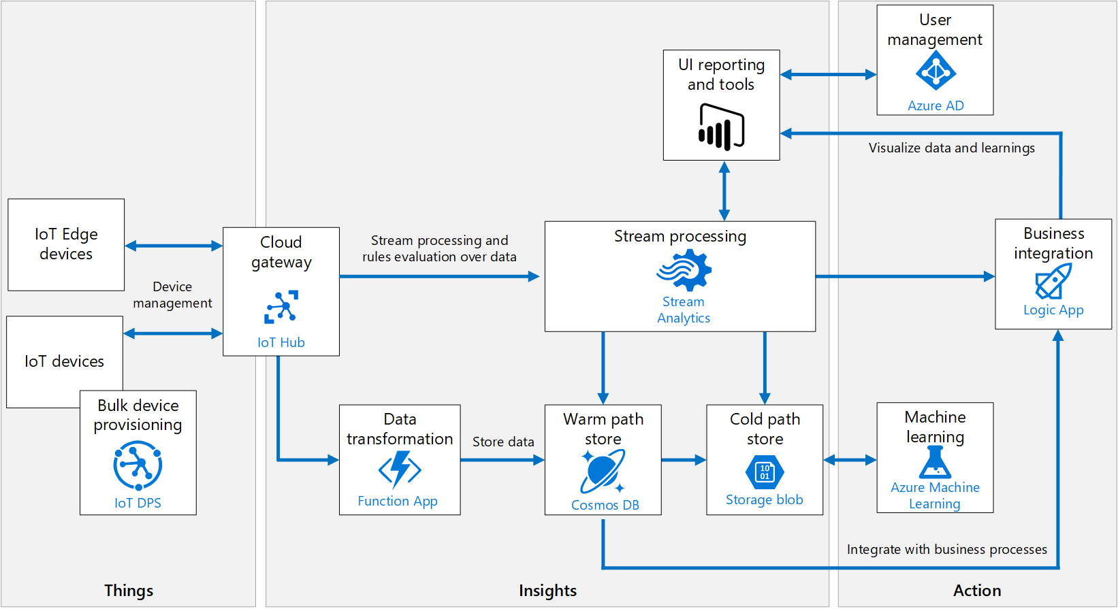
Azure IoT reference architecture
November 4, 2023
SE ZG651/ SS ZG653 Software Architectures
Ref: docs.microsoft.com

Slide 41
Appendix
November 4, 2023
SE ZG651/ SS ZG653 Software Architectures

